Slide 1
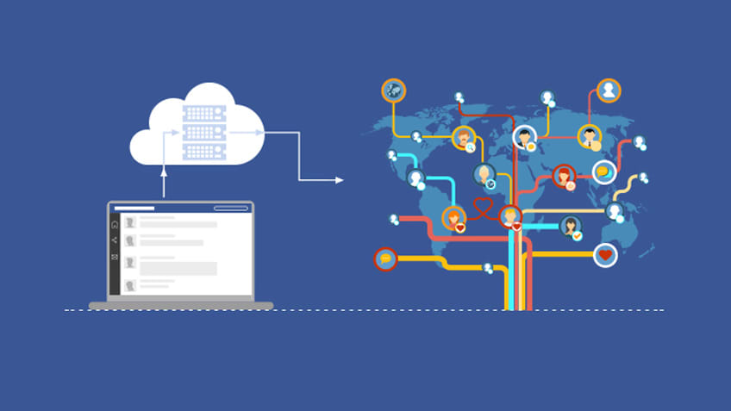
FACEBOOK DATA ANALYSIS
BY-
Ritesh Pamadi (1BM18IS080)
Omisha N (1BM18IS063)
Aditya A Kamat (1BM18IS003)

Slide 2
ABSTRACT
The concept of big data has been around for years; most organizations now understand that if they capture all the data that streams into their businesses, they can apply analytics and get significant value from it. But even in the 1950s, decades before anyone uttered the term “big data,” businesses were using basic analytics (essentially numbers in a spreadsheet that were manually examined) to uncover insights and trends.
The new benefits that big data analytics brings to the table, however, are speed and efficiency. Whereas a few years ago a business would have gathered information, run analytics and unearthed information that could be used for future decisions, today that business can identify insights for immediate decisions. The ability to work faster – and stay agile – gives organizations a competitive edge they didn’t have before. Through our project we intend to carry out analysis on a preferably large dataset. So we have chosen the dataset obtained from several Facebook users. By carrying out certain operations, we intend to harness their data and use it to identify new opportunities.

Slide 3
PROBLEM STATEMENT
While using Facebook for business, people involved need to take a structured approach that ties their social media efforts to real business goals. Analytics give a lot of valuable information that can help them track and measure your results so they can refine your strategy and measure your return on investment.
Understanding how and when people interact with the content they post on Facebook is also an important way to make sure the Facebook algorithm works for them, rather than against you.
This guide to Facebook Insights will help you understand how and why each metric is important to your overall social media strategy.

Slide 4
INTRODUCTION
A Social network is defined as a network of relationships or interactions, where the nodes consist of people or actor, and the edges or arcs consist of the relationships or interactions between these actors. Social networks and the techniques to analyse them existed since decades.
Recently online social networks like Facebook, Twitter, LinkedIn, MySpace etc have been developed which gained popularity within very short amount of time and gathered large number of users. Facebook is said to have more than 500 million users.
Facebook is a preferred social network by marketers, not only because of the sheer number of users represented but also because of its incredibly insightful analytics suite. It’s important to be able to analyze customers and their behavior on a micro level due to Facebook’s ever-changing algorithm, and the implications for our content and business. If we refuse to adapt our approach based on these insights, we’re doomed to obscurity on the news feed. A deep Facebook data analysis shouldn’t be a one and done situation. Ideally, we’ll be auditing our efforts every few months or so at most. This will help us predict the likings, and the general summary of many users as a whole.

Slide 5
OVERVIEW OF THE PROJECT
In this project, we use Exploratory Data Analysis (EDA) on the Facebook dataset. It is the process of understanding the data sets by summarizing their main characteristics often plotting them visually. This step is very important especially when we arrive at modelling the data in order to apply Machine learning. Plotting in EDA consists of Histograms, Box plot, Scatter plot and many more. It often takes much time to explore the data. We implement EDA on the Facebook dataset using Google Colab. We plot many graphs explaining details of the Facebook dataset and showing different analysis.
This exploratory data analysis gives insights from Facebook dataset which consists of identifying users that can be focused more to increase the business

Slide 6
HIGH LEVEL DESIGN

Slide 7
TOOLS USED
Google Colab- Colaboratory, or “Colab” for short, is a product from Google Research. Colab allows anybody to write and execute arbitrary python code through the browser, and is especially well suited to machine learning, data analysis and education. More technically, Colab is a hosted Jupyter notebook service that requires no setup to use, while providing free access to computing resources including GPUs.
Colab notebooks are stored in Google Drive, or can be loaded from GitHub. Colab notebooks can be shared just as you would with Google Docs or Sheets.

Slide 8
IMPLEMENTATION
import pandas as pd
import numpy as np
import seaborn as sns #visualisation
import matplotlib.pyplot as plt #visualisation
%matplotlib inline
sns.set(color_codes=True)
Loading the dataset into the frame
from google.colab import files
uploaded = files.upload
import pandas as pd
df=pd.read_csv('pseudo_facebook.csv')
df.head(5)
df.tail(5) # To display the botton 5 rows
Checking the types of data
df.dtypes
# computing number of rows
rows = len(df.axes[0])
# computing number of columns
cols = len(df.axes[1])
print(df)
print("Number of Rows: ", rows)
print("Number of Columns: ", cols)
df.shape
duplicate_rows_df = df[df.duplicated()]
print("Number of duplicate rows: ", duplicate_rows_df.shape)
df.count() # Used to count the number of rows
df.count()
Renaming
df = df.rename(columns={"likes": "Likes","userid": "User ID","age": "Age","gender": "Gender", "friend_count": "Friends", "www_likes": "Web Likes" })
df.head(5)
Dropping the missing values
print(df.isnull().sum())
df = df.dropna() # Dropping the missing values.
df.count()
print(df.isnull().sum()) # After dropping the values

Slide 9
plt.hist(x=df['tenure'])
plt.hist(x=df['Gender'])
plt.hist(x=df['Age'])
Q1 = df.quantile(0.25)
Q3 = df.quantile(0.75)
IQR = Q3 - Q1
print(IQR)
df = df[~((df < (Q1 - 1.5 * IQR)) |(df > (Q3 + 1.5 * IQR))).any(axis=1)]
df.shape
Plots
df.Gender.value_counts().nlargest(40).plot(kind='bar', figsize=(10,5))
plt.title("Gender")
plt.ylabel('Number of people')
plt.xlabel('Gender');
df.Age.value_counts().nlargest(40).plot(kind='bar', figsize=(10,5))
plt.title("Age")
plt.ylabel('Age')
plt.xlabel('Number of people');
df.dob_month.value_counts().nlargest(40).plot(kind='bar', figsize=(10,5))
plt.title("Birthday Month")
plt.ylabel('dob_month')
plt.xlabel('Number of people');
Heat Maps
plt.figure(figsize=(10,5))
c= df.corr()
sns.heatmap(c,cmap="BrBG",annot=True)
Scatterplot
fig, ax = plt.subplots(figsize=(10,6))
ax.scatter(df['Gender'], df['Friends'])
ax.set_xlabel('Gender')
ax.set_ylabel('Friends')
plt.show()
fig, ax = plt.subplots(figsize=(10,6))
ax.scatter(df['Age'], df['Friends'])
ax.set_xlabel('Age')
ax.set_ylabel('Friends')
plt.show()
fig, ax = plt.subplots(figsize=(10,6))
ax.scatter(df['Age'], df['mobile_likes'])
ax.set_xlabel('Age')
ax.set_ylabel('Mobile Likes')
plt.show()
fig, ax = plt.subplots(figsize=(10,6))
ax.scatter(df['Age'], df['Web Likes'])
ax.set_xlabel('Age')
ax.set_ylabel('Web Likes')
plt.show()

Slide 10
REFERENCES
https://www.simplilearn.com/how-facebook-is-using-big-data-article
towardsdatascience.com
medium.com
https://maxwellflitton.com/2018/03/23/basic-facebook-data-analysis-with-python/

